Slide 1
2023 Start Summit Hack: Case introduction (main stage)
1

Slide 2

Who we are
Your Trusted Partner
We enrich people’s lives by providing access to goods, services, and insights. United by our vision to be the trusted partner, we help companies grow.
Notes:
With our comprehensive services and network, we help companies grow their businesses in new and existing markets
We can provide business partners with the knowledge, advice, relationships, and on-the-ground logistics to reach their individual growth goals
With our help, business partners can expand their access to knowledge, their sourcing base, their revenue opportunities, and their market shares
Providing business partners with a comprehensive package of services to reach their individual goals is what we call Market Expansion Services

Slide 3



DKSH Is a Successful Market Leader
Nearly 160 years’ experience
2,200 clients 2,100 suppliers
32,600 specialists
11.3 billion Net sales (2022)
>10 years 4 markets average client relationship¹
21.8 million transactions per year
¹ Top 200 clients by net sales
Notes:
With nearly 160 years of experience, we are the clear market leader in our industry covering Asia Pacific, as well as selected markets in Europe and North America
In 2022, we generated net sales of 11.3 billion Swiss Francs
Our extensive capillary distribution system serves customers across Asia Pacific, Europe, and North America based on exclusive distribution contracts with 2,200 clients and 2,100 suppliers globally
On average, clients work with us in four markets and for more than ten years
With 32,600 specialists on the ground in the regions, we manage products and market information flows across four continents, supported by a standardized IT platform which processes 21.8 million transactions a year

Slide 4
We link business partners and add value to businesses
Client
Consumer goods, healthcare products
Customer
Manufacturer
B2B/B2C
Retailer
Manufacturer
Market insights
Market insights
B2B
Specialty chemicals and ingredients, analytical instruments, capital investment goods
We support our clients in marketing, selling and distributing products, provide after-sales services, and market insight in new and existing markets
We support our customers in getting the best raw materials, products and brands at the best price, and we provide them with knowledge and market insights
Notes:
With our services, we link business partners and add value to them
On the one hand, we work with manufacturers who produce fast moving consumer goods, luxury and lifestyle products; pharmaceuticals, consumer health products and medical devices; specialty chemicals and ingredients; and advanced machinery or technical equipment. We support these clients in all the steps necessary to bring their products to their end-customers. We support our clients marketing, selling and distributing products, providing after-sales services, and market insight in new and existing markets
On the other hand, we have a second type of business partner. This can be either another manufacturer to whom we provide technical equipment or raw materials, which are processed or used in their own production; retailers such as supermarkets, department stores, mom-and-pop stores, luxury and apparel boutiques; or doctors, hospitals, and pharmacists who resell the products we provide to end consumers. We support both customers getting the best raw materials, products, and brands at the best prices and we provide them with knowledge and market insight

Slide 5



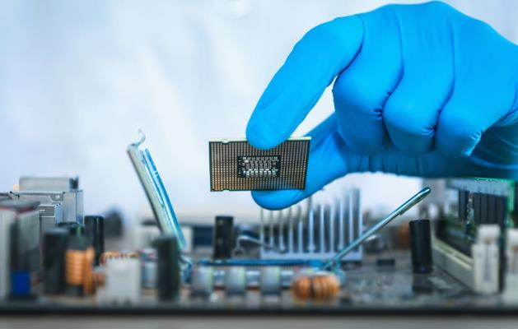
Our industry expertise Four Highly Specialized Business Units
Consumer Goods
Net sales:
CHF 3.7 billion
Specialists: 18,850
Healthcare
Net sales:
CHF 5.6 billion
Specialists: 7,990
Performance Materials
Net sales:
CHF 1.5 billion
Specialists: 1,650
Technology
Net sales:
CHF 513.2 million
Specialists: 1,690
Notes:
Our strategy for growth is enabled through a corporate structure that is designed to provide deep specialization
We are organized into four highly specialized Business Units, with a flexible and efficient operation. As you see, the Business Units are called Consumer Goods, Healthcare, Performance Materials, and Technology
This Business Unit structure produces in-depth expertise, skill, and industry specific know-how
This is how we can ensure that business partners always talk to experts in their particular field. As our Business Units operate close to the markets and in collaboration with local partners, we always strive to develop the best ideas and strategies for the given environment and situation in which our clients aim to grow their business

Slide 6
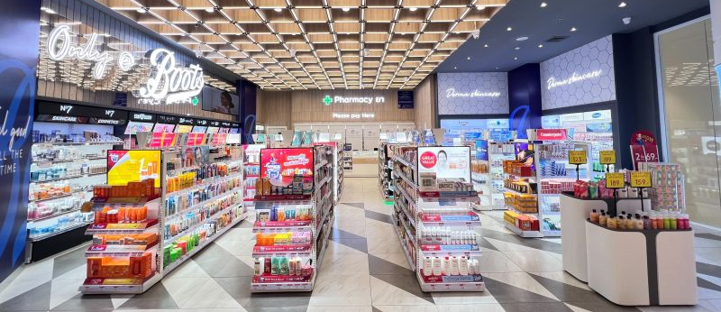
The business case: build a one-stop digital pharmacy solution delivering a seamless patient care experience

Slide 7
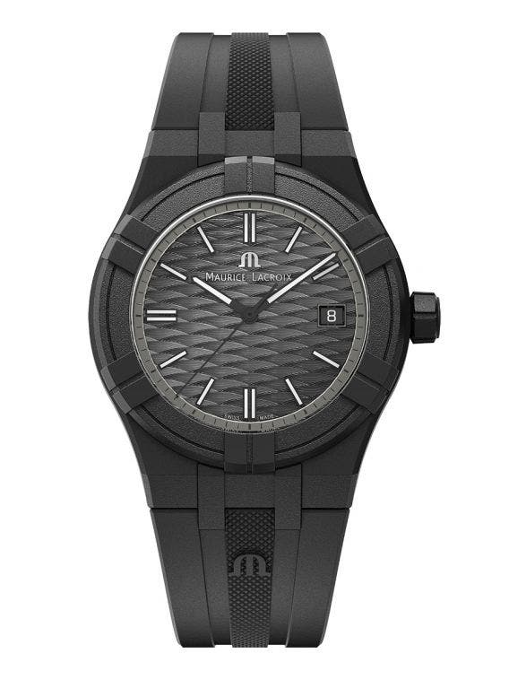
The prize: Maurice Lacroix Aikon Tide

Slide 8
Evaluation criteria
UX/UI and digital solution patient journey: How easy and seamless is it for patients to use the solution to interact with pharmacies?
New features / use cases: additional, relevant features to enhance the patient experience

Slide 9
Thank you for your attention

